Slide 1
Oregon Sick Time Law

Slide 2
Trends in implementation of working conditions laws in Oregon
Adoption of local ordinances precursors to state law, e.g., minimum wage rates, sick leave, work schedules
Multiple legislative sessions before passing
Distinctions between urban and non-urban areas, e.g., employee thresholds; different provisions (wage rates, paid v. unpaid sick time)

Slide 3
Paid v. Unpaid Sick Time
Employers with 10 or more employees (6 or more if the employer is located in Portland) must pay employees for sick time.
All other employers must provide unpaid sick time.

Slide 4
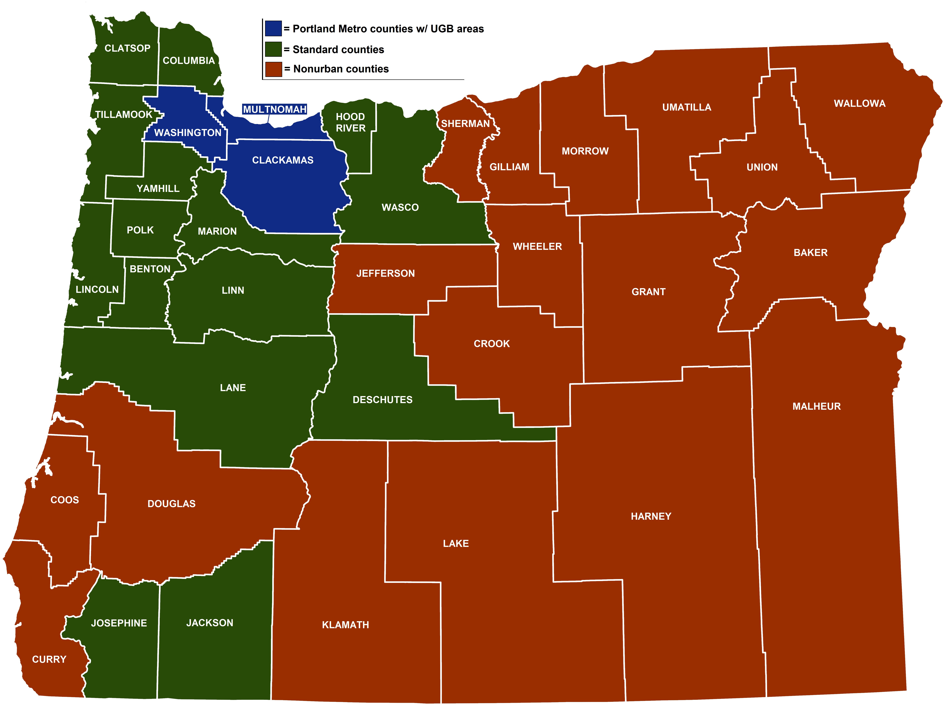
 | Standard “Region 1” | Metro Urban Growth Boundary “Region 2” | Nonurban counties “Region 3”
January 1, 2016 | $9.25 | $9.25 | $9.25
July 1, 2016 | $9.75 | $9.75 | $9.50
July 1, 2017 | $10.25 | $11.25 | $10.00
July 1, 2018 | $10.75 | $12.00 | $10.50
July 1, 2019 | $11.25 | $12.50 | $11.00
July 1, 2020 | $12.00 | $13.25 | $11.50
July 1, 2021 | $12.75 | $14.00 | $12.00
July 1, 2022 | $13.50 | $14.75 | $12.50
July 1, 2023 | Adjusted annually based on the increase, if any, to the US City average Consumer Price Index for All Urban Consumers | $1.25 over the standard minimum wage | $1 less than the standard minimum wage
Oregon Minimum Wage Rates
Notes:
Employees are entitled to accrue and use 40 hours of Protected Sick Time during a year, but employers are not required to use a calendar year when complying with the ordinance.

Slide 5
Requirements of Oregon’s Sick Time Law: Accrual
Employees begin accruing sick time on the first day of employment
Employees earn one hour of sick time for every 30 hours or 1 1/3 hours for every 40 hours worked*
Employees may use accrued sick time after 90 days of employment
Employers may “front load” 40 hours of sick time at the beginning of the year rather than track sick time hours accrued
*FLSA exempt employees paid on a salary basis are presumed to work 40 hours each work week for purposes of accruing Oregon Sick Time unless the actual work week is less than 40 hours, in which case Oregon Sick Time accrues based on the actual work week.

Slide 6
Existing PTO, vacation plans
Employers with a sick leave policy, vacation policy, paid personal time off or other paid time off program that is substantially equivalent to the minimum requirements of Oregon Sick Time are deemed to in compliance with the law.

Slide 7
“Employee” – Exceptions
The following are not employees:
Employees receiving paid sick time under federal law
Independent Contractors
Work Training participants
Work-Study participants
Railroad Workers
I
Individuals employed by the individual’s
parent, spouse or child.

Slide 8
Qualifying Absences
An employee may use Oregon Sick Leave for the diagnosis, care, or treatment of the employee or the employee’s family member’s mental or physical illness, injury, or health condition.
Diagnosis, care or treatment, includes preventive (routine medical/dental visits)
Family member’s diagnosis, care or treatment, includes preventive
All OFLA covered absences
Domestic violence, harassment, sexual assault or stalking
Public health emergencies which closes school, work or child care

Slide 9
Family Members
“Family Member” with Oregon Sick Time is the same as Oregon
Family Leave Act
Spouse ● Grandparent
Same-gender domestic partner ● Grandchild
Custodial parent ● In loco parentis
Non-custodial parent ● Biological child
Adoptive parent ● Adopted child
Foster parent ● Foster child
Biological parent ● Stepchild
Stepparent ● Child of same gender
Parent in law domestic partner
Parent of employee’s same-gender
domestic partner
Notes:
“Domestic Partner” means an individual joined in a domestic partnership. “Domestic Partnership” means a civil contract described in ORS 106.300 to 106.340 entered into in person between two individuals of the same sex who are at least 18 years of age, who are otherwise capable and at least one of whom is a resident of Oregon.
“In loco parentis” means in the place of a parent, having financial or day-to-day responsibility for the care of a child. A legal or biological relationship is not required.

Slide 10
Family members who are NOT covered:
Opposite-sex domestic partners
Siblings*
Cousins*
Aunts and uncles*
* EXCEPTIONS for in loco parentis relationships.
Notes:
Example of an exception: If an employee’s aunt was in loco parentis to the employee at some point during the employee’s childhood, that employee could use Protected Sick Time to care for that aunt.

Slide 11
Accrual and Carryover Caps
An employee begins to earn and accrue sick time on the first day of employment and may carry over up to 40 hours of unused sick time from one year to the next.
However, an employer may adopt a policy:
Capping accrual at 80 hours
Capping 40 hours of sick leave in a year.

Slide 12
Intersection with other Leave Laws
OFLA/FMLA: Oregon Sick Time runs concurrently if the employee is eligible for OFLA and/or FMLA and the absence also qualifies under OFLA and/or FMLA

Slide 13
CBA Exemption*
The Oregon Sick Time Law does not apply to an employee whose terms and conditions of employment are:
a) covered by a collective bargaining agreement,
b) who is hired through a hiring hall or similar referral system operated by the labor organization or a third party, and
c) whose employment-related benefits are provided by a joint multi-employer-employee trust or benefit plan.
*All three of these criteria must be met for this exemption to apply

Slide 14
Employee Notice
Employers may require reasonable advance notice for use of Oregon Sick Time if the leave is foreseeable.
If the Oregon Sick Time Leave is unforeseeable the employee needs to provide notice as soon as practicable.

Slide 15
Documentation
If an employee takes more than three consecutive scheduled workdays for Oregon Sick Time, an employer may require verification from a health care provider of the need for leave.
Medical verification is required to be provided within 15 calendar days.
Employer needs to pay for any out of pocket costs, including any lost wages.

Slide 16
Documentation
Health Care Providers defined to include:
Physician Registered Nurse
Dentist Nurse Practitioner
Psychologist Midwife
Optometrist Social Worker
Naturopath Chiropractic Physician

Slide 17
Required Quarterly Employer Notice to Employees
Employers are required to provide employees with quarterly written notices of the amount of accrued and unused Oregon Sick Time available for use by the employee.
Inclusion of this information in paycheck stubs complies with this requirement.

Slide 18
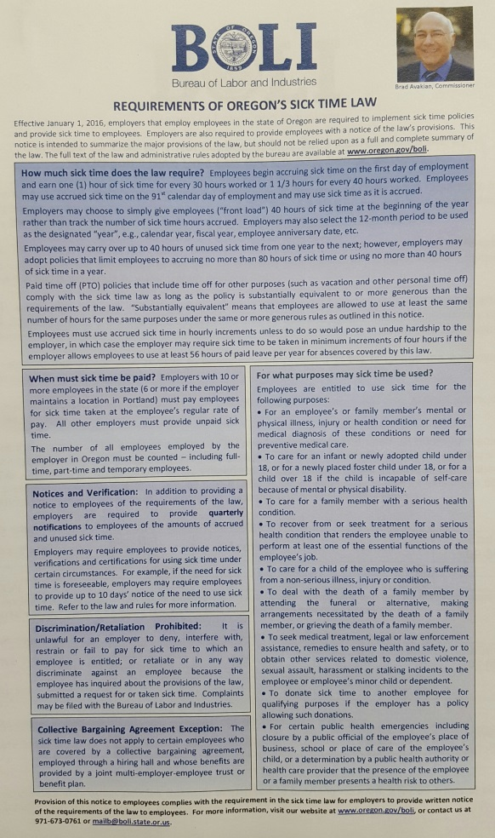
Employer Notice to Employees
Employers are required to provide employees with written notice of the requirements for Oregon Sick Time.

Slide 19
Unlawful Practices:
An employer may not:
Require an employee to find a replacement or
Work an alternate shift to make up the use of sick time
(However, upon mutual consent between employer and employee an employee can make up the time they were absent without using sick leave, however, the employer may not require the employee to work additional hours or shifts.)
Deny, interfere with, restrain or fail to pay for sick time
Retaliate or discriminate against an employee because the employee has:
Inquired about;
Submitted a request for; or
Taken sick time

Slide 20
Safe Harbor
Civil Penalties may not be assessed for Oregon Sick Time violations until January 1, 2017.*
*Does not cover civil suits

